Slide 1
MINI PROJECT ON CLUSTERING
PREPARED BY – JITENDRA GIRISH PATIL

Slide 2
MINI PROJECT ON CLUSTERING
TABLE OF CONTENTS –
Explanation of what the project is all about ?
Describing the data : Its source, datatypes, description and information.
Data Pre - Processing techniques used, How the missing value is handled and Feature engineering techniques used.
EDA and the interpretations from your visualizations.
Model building : whether used one model or more, Algorithms used in the model and the reason for choosing it and Cross validation result if used.
Evaluation of the performance of the models, and final conclusion of best model which can be used.

Slide 3
What the project is all about...
A Good Sales is always about understanding the target audience which can be grouped under some ways like Shopping pattern, spending pattern, shopping score, salary etc.
The store owner can strategize its offerings in such a way that it targets only right customers of a group for specific products. This helps in creating a win-win situation for both the store (in terms of revenue and more customers through customer recommendation) and the customer (discounts, offers, reward points, gifts, etc.).
To solve this issue we have to create some clusters based on customers characteristics.

Slide 4
Describing the Data
The data contains total 200 rows and 5 columns. Following are the columns and dtypes
FEATURE | DATA TYPE | DESCRIPTION
Customer Id | Numeric | Customer unique identification number
Gender | Character | Gender of the customer
Age | Numeric | Age of the customer
Annual Income (kS) | Numeric | Annual income of the customer
Spending Score (1-100) | Numeric | Spending scores by customer to purchase Products

Slide 5
Data Pre-Processing Techniques
Null Value Treatment - In Pre-Processing, First of all we checked for empty values, there were no empty values, so there is no need of missing value imputation.
Label Encoding - Then the non numeric data type feature were converted into numeric type as the machine understands numeric values very well using the method(Label Encoder).

Slide 6
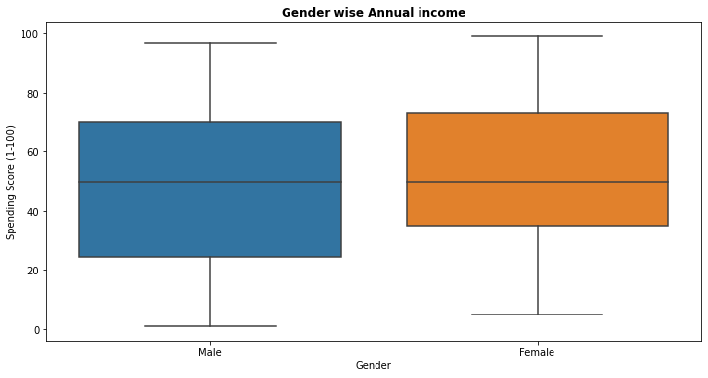

EXPLORATORY DATA ANALYSIS
Interpretation :
Most of the income is of Male Gender between range 50-90K and for Female most of the have income from 20-90K.
For Male the spending score is most in the range 30-55 and for Female, it is from 35-55.

Slide 7
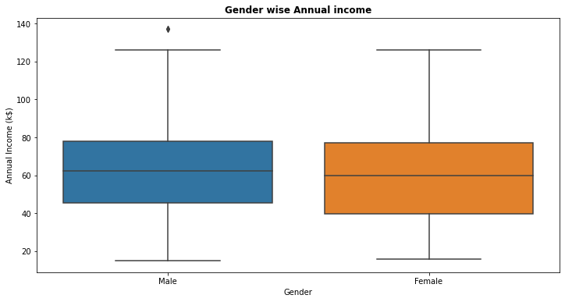
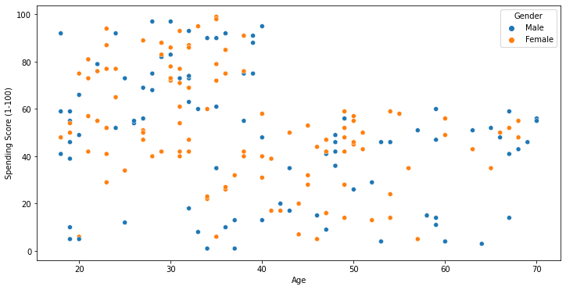
EXPLORATORY DATA ANALYSIS

Slide 8
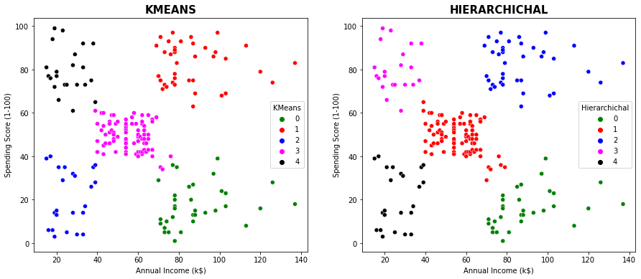
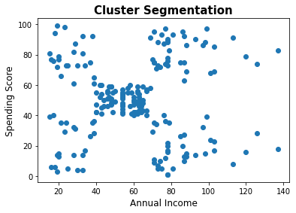
EXPLORATORY DATA ANALYSIS
Interpretation :
Here we can see the cluster formation, but right now we cant distinguish between the type of clusters they are.
In the Second graph we can see that the clusters are formed and we can distinguish between the customers segmentation

Slide 9
Model Building
There were total 2 models used to get the best model which can give the best performance and cluster formation. Following are the models
KMeans Model
Hierarchical Clustering
Performance→ 0.555
Performance→ 0.554

Slide 10

Evaluation and Final Conclusion of Best Model
Final Conclusion -
There were 2 models prepared for getting the best Clustering an Performance – KMeans & Hierarchical Clustering
KMeans Clustering can be said as best model among other models.
As the Performance of Silhouette Score(Goodness of clustering) is comparatively good than other models
Visually also we can see better cluster formation.

Slide 11
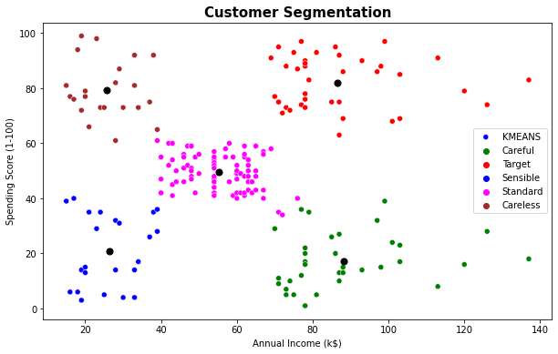
BUSINESS IMPLICATIONS
We can that the Target, Standard and Careless cluster people are the target audience for Mall as they have high Spending Score.
Even though the Careless Cluster people have less Annual Income they have high Spending Score. But one thing the Shop owners in mall have to remember that the Careless Cluster people can be a liability for the business as they may use credit card but don't pay out the amount because of less income. So selling items to these people should be done cautiously.
Standard Cluster people fall in standard cluster which means they can buy some item but they are sensible in buying and buy only those items that they need.
Sensible and Careful Cluster people shouldn't be considered for sales as they don't have much Spending score even though they have good income.
So, Focusing on Target and Standard Cluster people would benefit the Sales as we can provide discounts offers, reward, gifts etc. to customers so that they will get benefited from the offers and also the store will make the profit from that.

Slide 12
THANK YOU

